Slide 1



Coordinated Microanalysis of Lunar Soils in Preparation for Future Returned Samples
Dayana Moreno Huerta
Dr. Jessica Barnes, LPL
University of Arizona

Slide 2
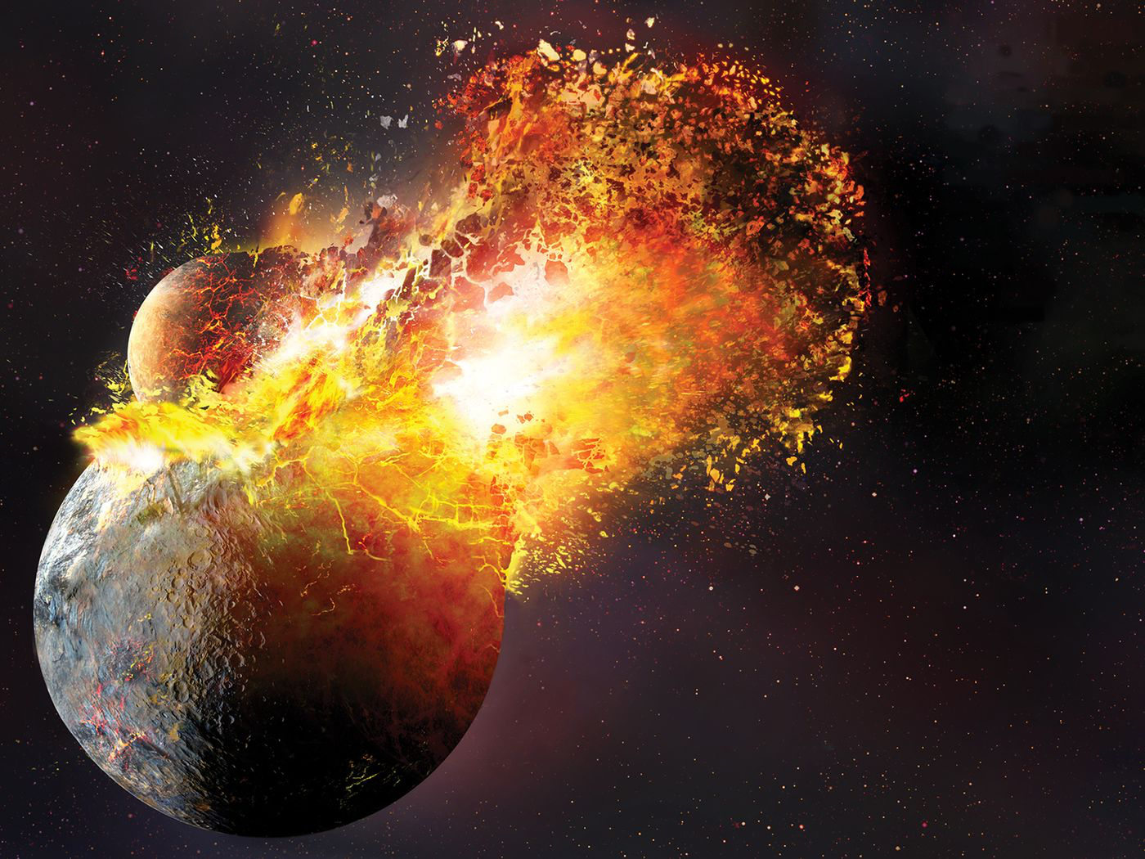
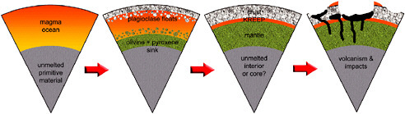
Moon’s Formation & Evolution
1. Giant Impact Event → the Moon forms
2. The Moon’s core forms
3. Lunar Magma Ocean (LMO)
→ mantle, crust, and lunar volcanism
Image credit: theverge.com (left), The National Academies Press (right)
Notes:
Giant Impact Hypothesis → Moon forms
Moon’s core & magma ocean form
Lunar Magma Ocean (LMO)
Moon’s crust forms
Moon’s mantle forms
Led to volcanism on the Moon
Lunar Volcanism

Slide 3
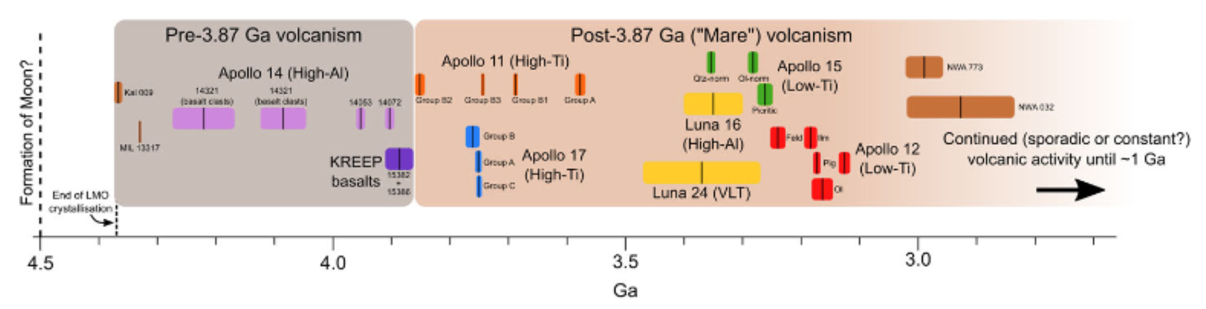
Lunar Volcanism
Partial melting of mantle → magma, volcanism, rocks
Timeline
Soviet Luna Missions
Image credit: Tartèse et al. 2021 SSR

Slide 4
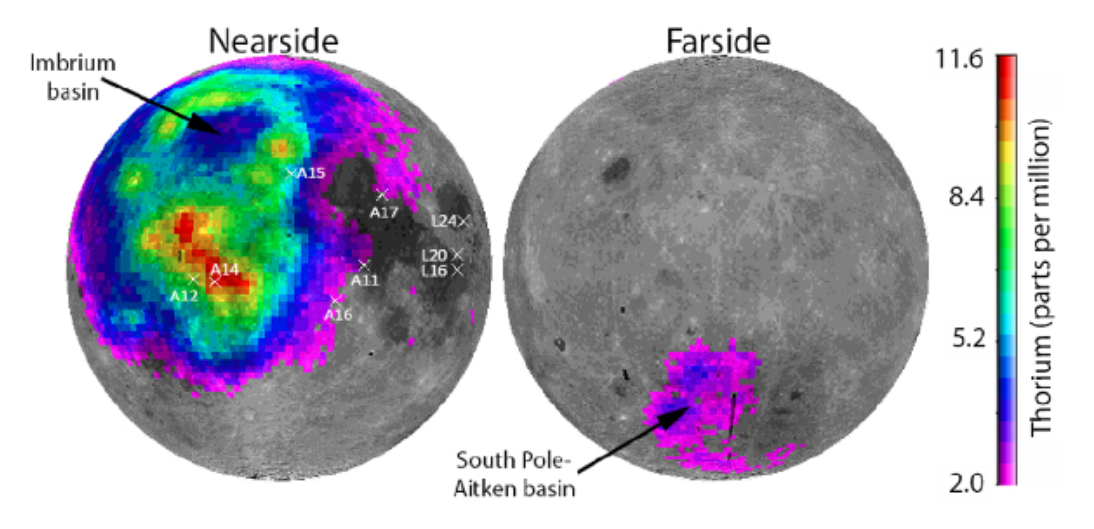
Lunar Volcanism
Partial melting of mantle → magma
Chemistry
Soviet Luna Missions
Image credit: Tartèse et al. 2021 SSR

Slide 5
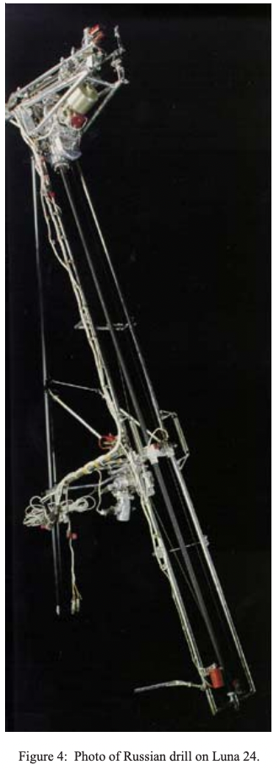
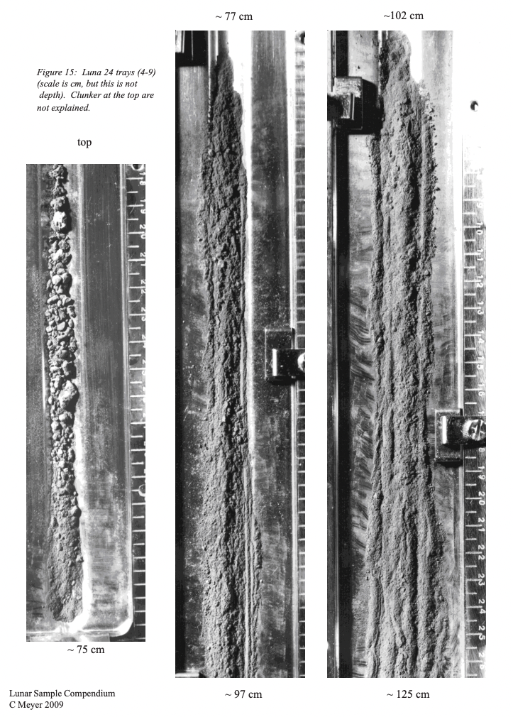
Luna Missions & Samples
Samples robotically collected as cores
Each core was then dissected and each dissection was given a sample number
e.g., 24174 is from Luna 24 at the 174th cm mark

Slide 6
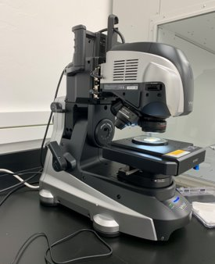
Techniques
Sample 24174,65 (PPL)
Thin sections of Luna 16 and 24 soils
Keyence VHX-7000
digital microscope

Slide 7
Techniques
PPL
RL
XPL
Plane polarized light
Reflected light
Cross polarized light

Slide 8
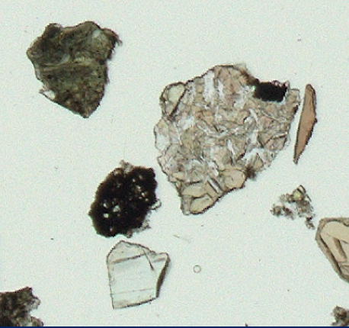
Techniques
highlands
basalt
breccia
Mineral
PPL
Classification of soil fragments

Slide 9
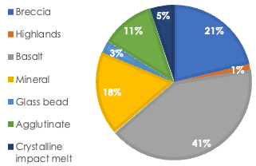
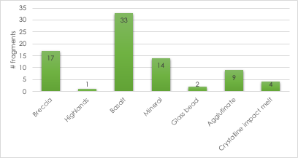
Results

Slide 10
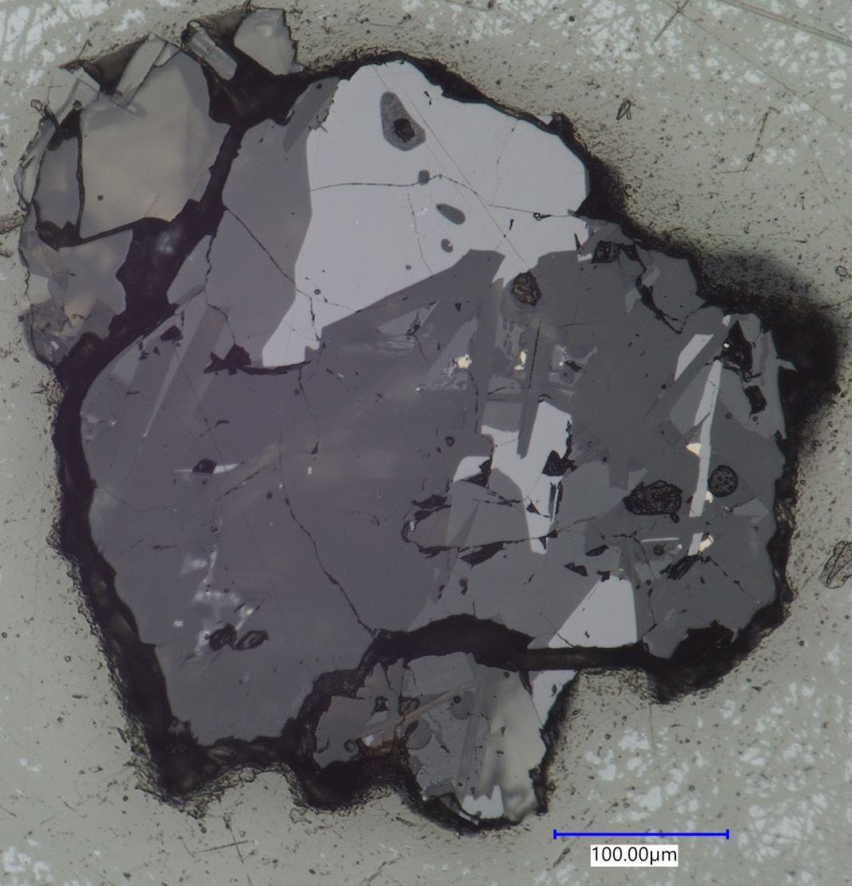
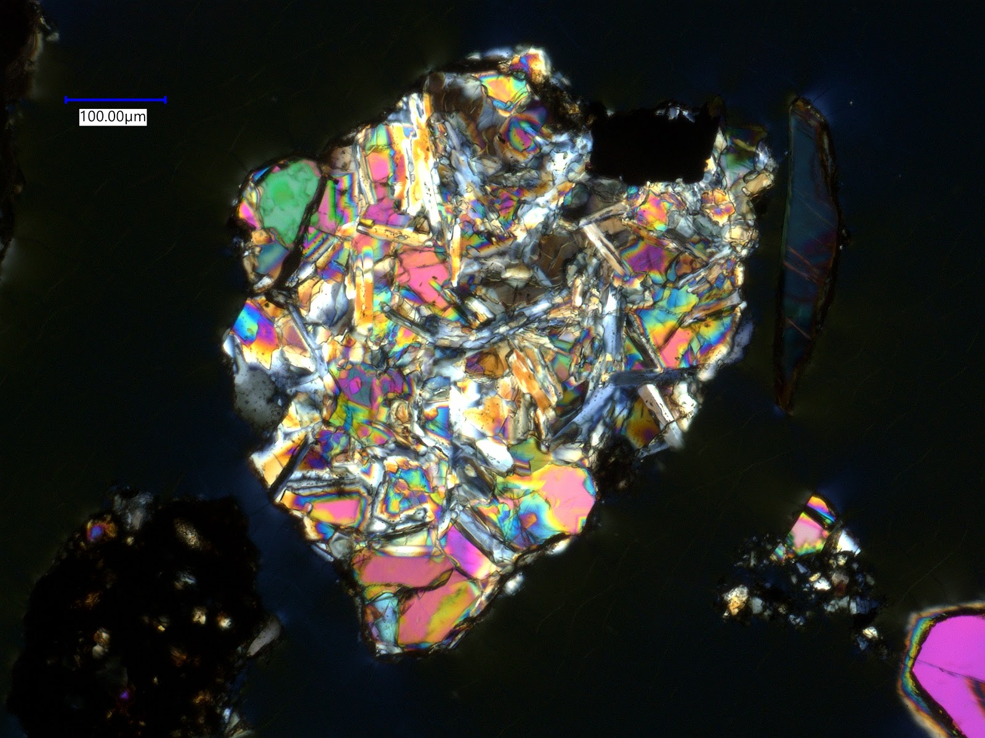
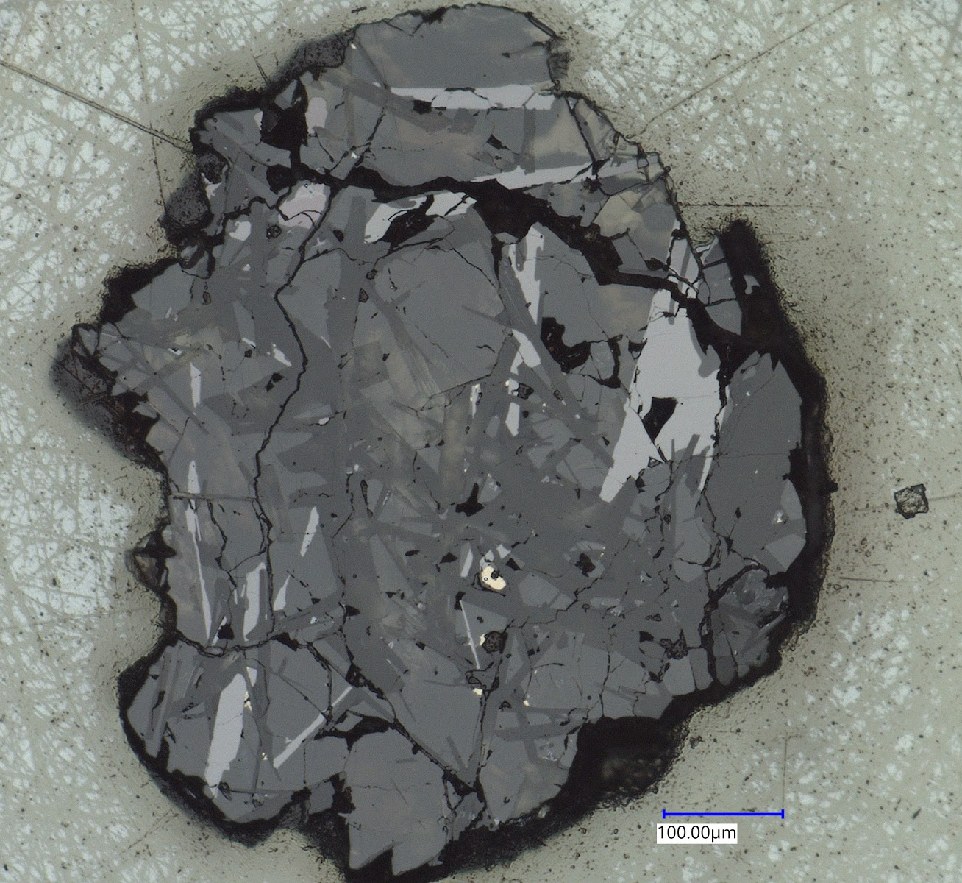
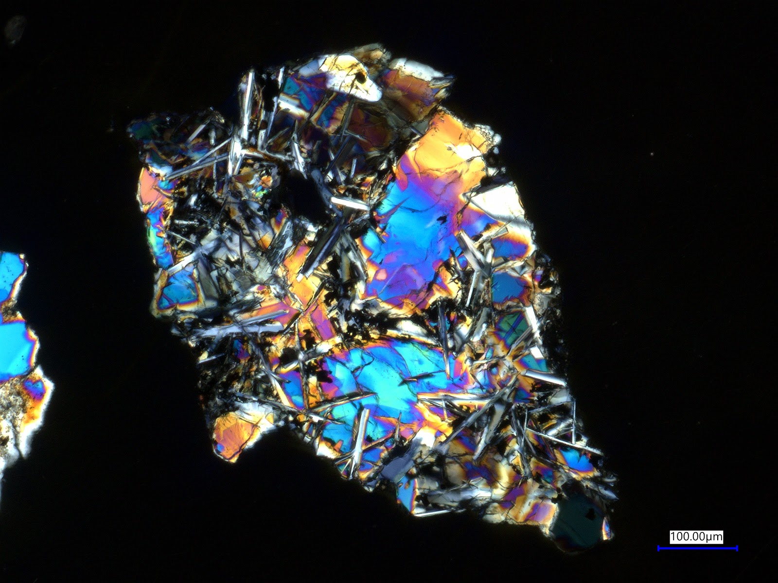
Results (cont.)
Fragment A, 21003,6
10 basalt fragments from both Luna 16 and 24 samples were selected for further analysis by scanning electron microscope
Selection was made to cover a range of textures, grain size, and mineralogies
Fragment O, 24714,65
Fragment B, 21003,6
Fragment B, 24210,43

Slide 11
Conclusion
Luna 16 and 24 soils collected from the eastern limb of the lunar nearside contain a wide variety of lithic (rock) fragments
Luna basalt fragments display a range of textures and mineralogies
  Indicating a range lava chemistries and cooling rates

Slide 12
Acknowledgements
Special thank you to the Arizona Space grant for this internship and to NASA CAPTEM for allocation of Luna samples to this project

Slide 13
Thank You!

